Slide 1

2025
SAFETY, SIGNALS, AND SUPPORT: TRAUMA-INFORMED RAPPORT BUILDING WITH NEURODIVERGENT CLIENTS
AC Goldberg (he/him) PhD CCC/SLP

Slide 2


LEARNER
Outcomes
1
Identify communication behaviors that may reflect trauma responses in neurodivergent clients.
2
Evaluate the role of clinician self-awareness, communication style, and power dynamics in building therapeutic rapport.
3
Develop personalized, trauma-informed strategies that affirm clients' communication preferences and foster co-regulation in therapy.

Slide 3

ABOUT ME
AC Goldberg (he/him) is a neurodivergent, physically disabled, intersex/transgender professor at Northeastern University and contractor at Prismatic Speech Services. His mission is to cultivate affirming spaces for all people and to be the role model he needed as a younger professional. AC’s work centers around empathy, humanity and intersectional cultural responsiveness. His continuing education nonprofit, The CREDIT Institute, is dedicated to advancing equity in educational and healthcare settings. AC is considered a top international educator in gender-affirming voice, trauma-informed care and neurodiversity inclusive practices. As a founding member of the Trans Voice Initiative, he has dedicated countless hours to mentoring and educating younger TGNC SLPs. AC is the 2022 recipient of the American Speech Language Hearing Association’s (ASHA) Outstanding Service Award. If you’d like to get to know him, he's @transplaining Instagram.
Financial Disclosures:
AC is an Assistant Clinical Professor at Northeastern University, the founder of The CREDIT Institute Inc and a contractor with Prismatic Speech Services.
Non-Financial Disclosures:
AC serves on the community advisory board overseeing research out of Boston University about the effects of exogenous testosterone therapy on communication in AFAB speakers. He’s a community partner with CHAT Life Changing Speech Therapy and Boothby Therapy Services AC is also on the editorial board of the Journal of Communication Disorders and Journal of Voice Disorders.

Slide 4

INTERSECTIONALITY AND POWER DIFFERENTIALS 101
  Power in Society
2.Power in clinical
dynamics

Slide 5
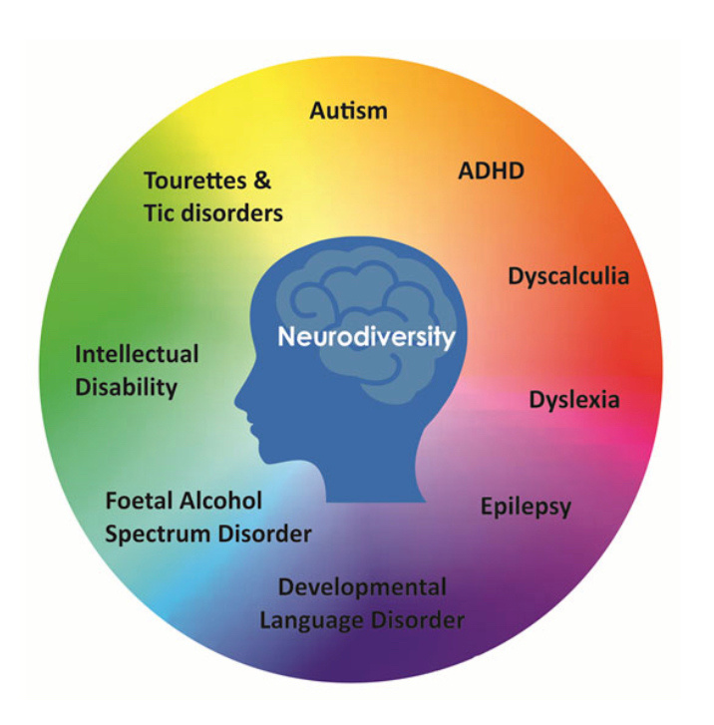
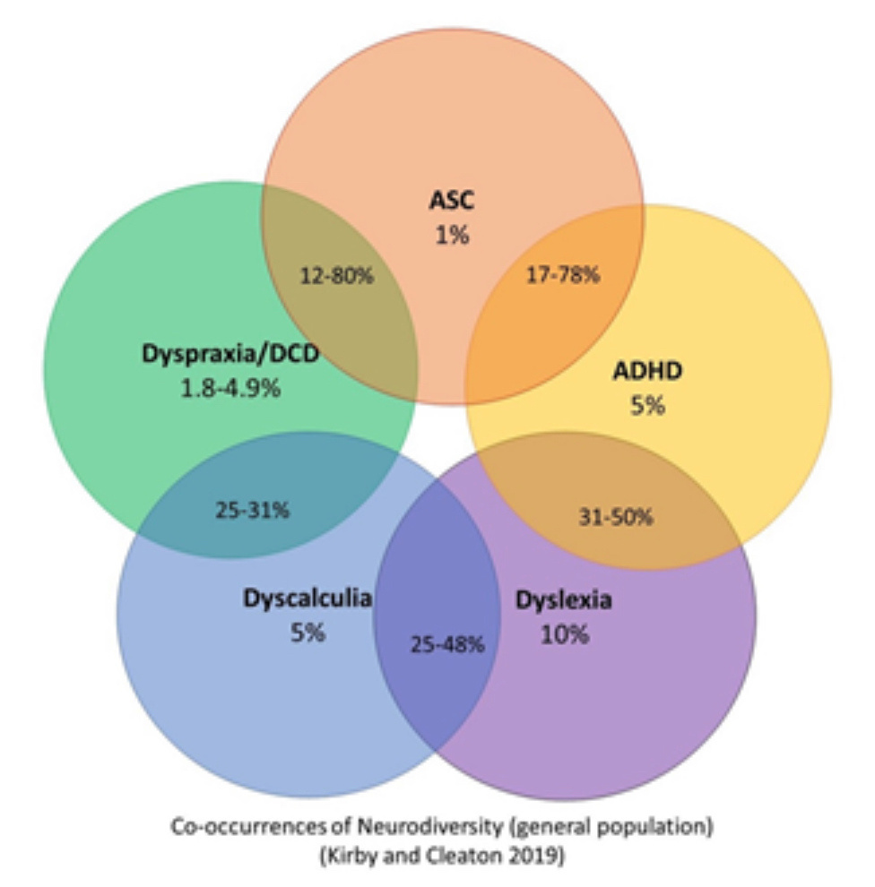
WHAT’S MISSING?

Slide 6

NEURODIVERGENT:
Someone whose neurotype falls outside of what’s considered the “presumed default”
NEURODIVERSITY:
A term that applies to people of all neurotypes, including neurotypical people

Slide 7
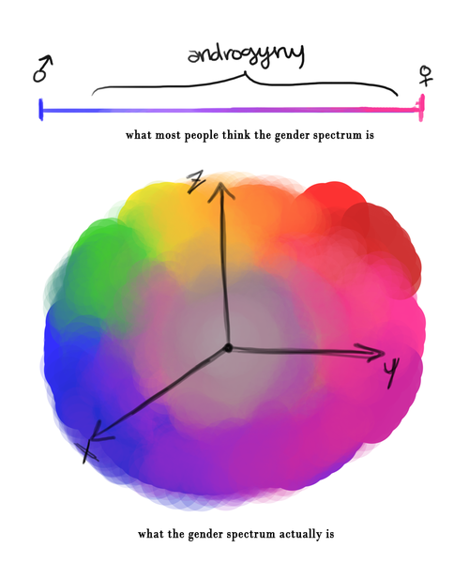
CONSIDER YOUR GENDER...
  Spectrums
  Continuums
  Binary brain traps
WHAT IS GENDER DIVERSITY?

Slide 8
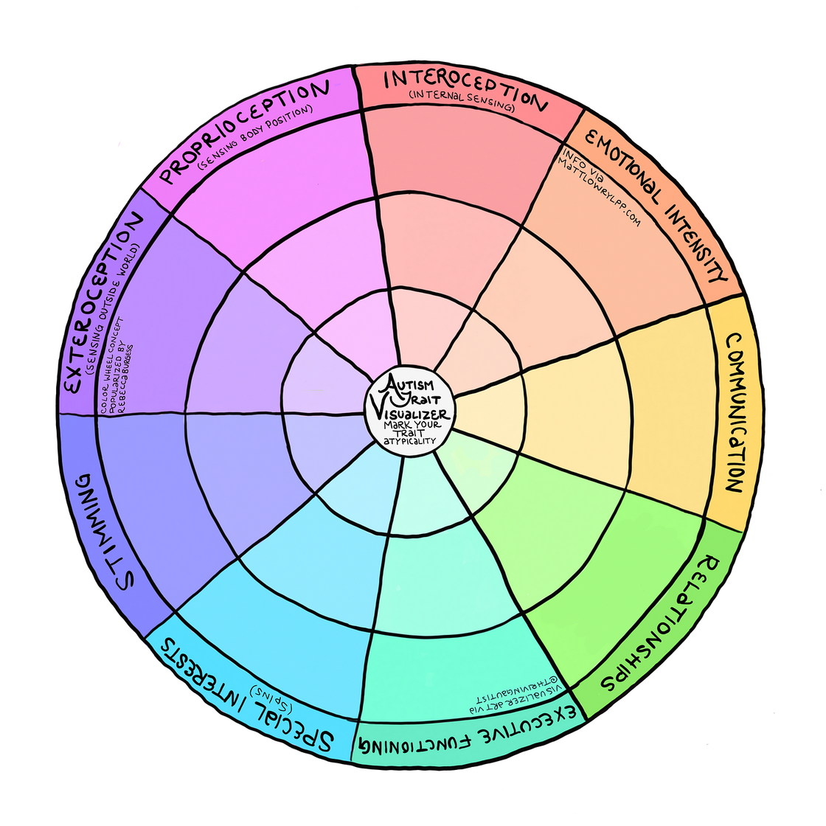
WHEN SPECTRUMS CONVERGE...POWER DIFFERENTIALS EMERGE.

Slide 9
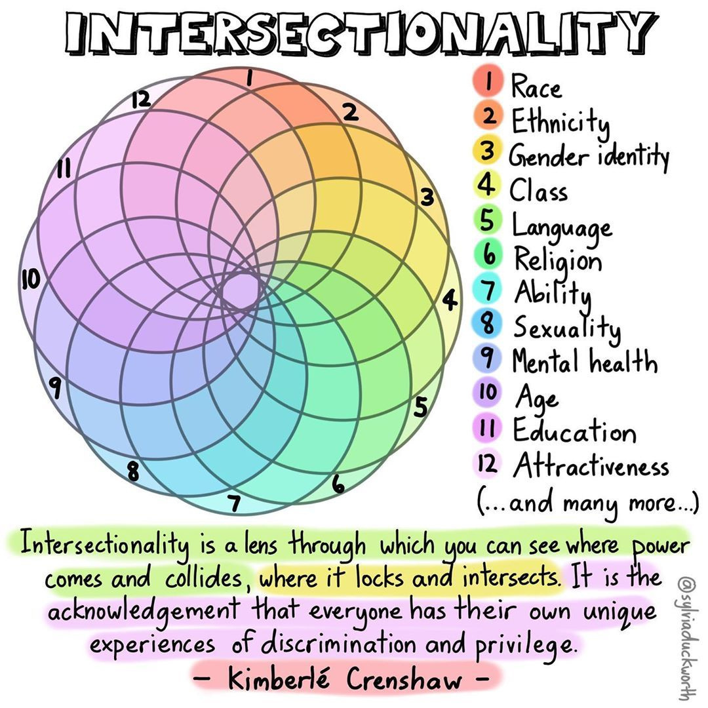
“INTERSECTIONALITY IS A LENS THROUGH WHICH YOU CAN SEE WHERE POWER COMES AND COLLIDES, WHERE IT LOCKS AND INTERSECTS. IT IS THE ACKNOWLEDGMENT
THAT EVERYONE HAS THEIR OWN UNIQUE EXPERIENCESOF DISCRIMINATION AND PRIVILEGE” -KIMBERLE CRENSHAW

Slide 10
HOW DOES THIS CREATE OR REINFORCE TRAUMA?
  Microaggressions in all settings
  Invalidation and lack of equitable treatment options
  Rejection and having to “prove” things
  Societal mistreatment compounded
  Providers not seeing you as capable of being a partner in decision-making

Slide 11
WHAT CREATES INSTITUTIONAL TRAUMA?
  Barriers to care (racism, linguicism, ableism, transphobia, etc)
  Lack of access to appropriate treatments
  Neurotype masking
  Pervasive negative experiences due to provider bias
  Identity masking
  Gender performance
  Dialectical code switching
“Appear like everyone expect you to so that you’re treated better”
Systems are designed for those who fit in, not those who stand out.

Slide 12
IMPACT OF TRAUMA
Diminished trust:
Individuals may experience a significant decrease in trust towards institutions, authority figures, and even other people within that system, leading to difficulty forming healthy relationships.
Emotional distress:
Symptoms like anxiety, depression, anger, and feelings of hopelessness can arise due to the ongoing experience of institutional betrayal.
Powerlessness:
Feeling like one has no control over their situation within the institution can lead to feelings of helplessness and resignation.
Isolation:
Individuals may withdraw from social interactions or feel disconnected from others due to the trauma experienced within the institution.
Physical health issues:
Chronic stress from institutional trauma can manifest in physical symptoms like headaches, digestive problems, and weakened immune system.
Decreased work performance:
In a workplace setting, institutional trauma can lead to reduced productivity, absenteeism, and increased conflict among employees.
Social withdrawal:
Individuals may become less engaged in community activities or political participation due to a lack of trust in systems.

Slide 13
PRINCIPLES OF TRAUMA-INFORMED CARE
Safety
Choice
Collaboration
Trustworthiness
Empowerment
Ensuring physical and emotional safety.
Individual has choice and control.
Making decisions with the individual and sharing power.
Task clarity, consistency and interpersonal boundaries.
Prioritizing empowerment through skill/rapport building.

Slide 14
TRAUMA-INFORMED CARE
IN PRACTICE
Safety
Choice
Collaboration
Trustworthiness
Empowerment
Common areas are welcoming and privacy is always respected
Individuals are provided a clear and appropriate message about their treatment and rights in the space.
Individuals are provided a significant role in the planning of services.
Respectful and professional boundaries are maintained.
Providing an atmosphere in which individuals are able to feel validated and affirmed with each contact.

Slide 15
WHAT IS EMPATHY?
  “The action of understanding, being aware of, being sensitive to, and vicariously experiencing the feelings, thoughts, and experience of another” (merriam webster)
  Compassion and empathy both refer to a caring response to someone else’s distress. While empathy refers to an active sharing in the emotional experience of the other person, compassion adds to that emotional experience a desire to alleviate the person’s distress.

Slide 16



RAPPORT BUILING
EXPRESSING GENUINE EMPATHY
WITHHOLD JUDGEMENT
CHECK IN
Faking empathy to maintain decorum may be interpreted as gaslighting.
CHECK YOUR BIASES
BE HONEST

Slide 17
IS THE “DOUBLE EMPATHY PROBLEM” REAL?
Mutual Misunderstanding as a One-Sided Burden:
While the "double empathy problem" describes communication difficulties between neurotypical and Autistic individuals, the responsibility for bridging these gaps disproportionately falls on Autistic people. Neurotypical providers often lack the understanding or willingness to adapt to Autistic communication styles.

Slide 18
IS THE “DOUBLE EMPATHY PROBLEM” REAL?
Cultural Bias in Empathy Definitions:
Neurotypicals often equate empathy with socially constructed norms, such as facial expressions or tone of voice, which do not always reflect genuine emotional connection. These standards marginalize Autistic expressions of empathy, which are often profound but deviate from neurotypical expectations.

Slide 19
IS THE “DOUBLE EMPATHY PROBLEM” REAL?
Impact of Misunderstanding:
Negative first impressions and misinterpretations by neurotypical professionals contribute to stigma, mental health challenges, and systemic inequities for Autistic individuals. Autistic people often "mask" their behaviors to conform, which can lead to trauma, burnout, mistrust, etc.
Do we TRUST the neurodivergent communication?

Slide 20
IS THE “DOUBLE EMPATHY PROBLEM” REAL?
Reframing Empathy:
The issue lies less in mutual misunderstanding and more in systemic neurotypical dominance in communication norms. Addressing this requires neurotypical individuals to prioritize authentic engagement and flexibility, shifting the burden of understanding toward a more equitable balance.

Slide 21
NEGATIVE EXAMPLES:
POSITIVE EXAMPLES:
  Sticking exclusively to empathy scripts without follow-through or personal disclosure
  Normalizing an experience that should be treated as unique
  Moving on when someone is in a vulnerable state
  Relating your own experiences or things you know are real to what the person says
  Being honest about knowing or not knowing what to do or how to react
  Allowing silence and time for feelings and disclosures to “sit”

Slide 22

REDUCE MASKING DEMANDS IN ACTIONABLE WAYS
1
2
3
4
1
Reduce expectations about how someone should act in your space
Accommodate sensory needs the same way you accommodate all bodily function needs.
Communicate clearly with statements like “you can stim in here” and “I will respect the name you wish to be called.”
Advocate both inside and outside of your space or more tolerable conditions for those you serve.

Slide 23
REDUCE MICROAGGRESSIONS IN ACTIONABLE WAYS
1
2
3
4
1
Make sure people can fill out your forms! Some forms are impossible for clients and families.
Avoid gendered and ableist “compliments” such as “you look pretty today” and “it’s nice to see you walking without a cane.”
Make an effort to pronouns all names accurately. This small curtousy goes a long way for many.
Don’t make assumptions about anyone’s gender, pronouns,abilities or sensory needs based on looks.

Slide 24
BRING YOURSELF TO THE ROOM...
  How would I feel/what would I need if I were in this persons’s situation?
  How would I to be treated if the roles were reversed?
  What can I change about the process or environment that will have a positive outcome for our therapeutic rapport?
  What biases may be preventing me from seeing the full picture, or what am I challenged by in this dynamic?
  Have I been honest with my client about what I’m thinking or am I putting up a facade to maintain decorum?

Slide 25
TRIGGER WARNING – CURRENT MAINSTREAM MEDIA HARM
FOR JEWISH PEOPLE AND OTHERS FROM BACKGROUNDS SENSITIVE TO AUTHORITARIANISM
(please feel free to step away and not look at the next
slide in the deck)

Slide 26


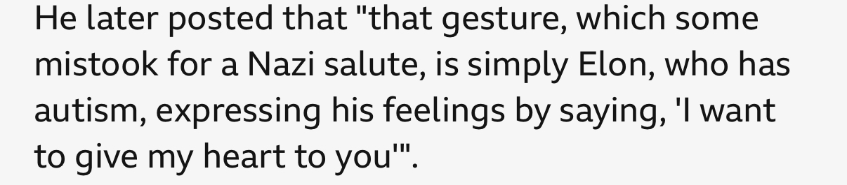







Slide 27


Slide 28
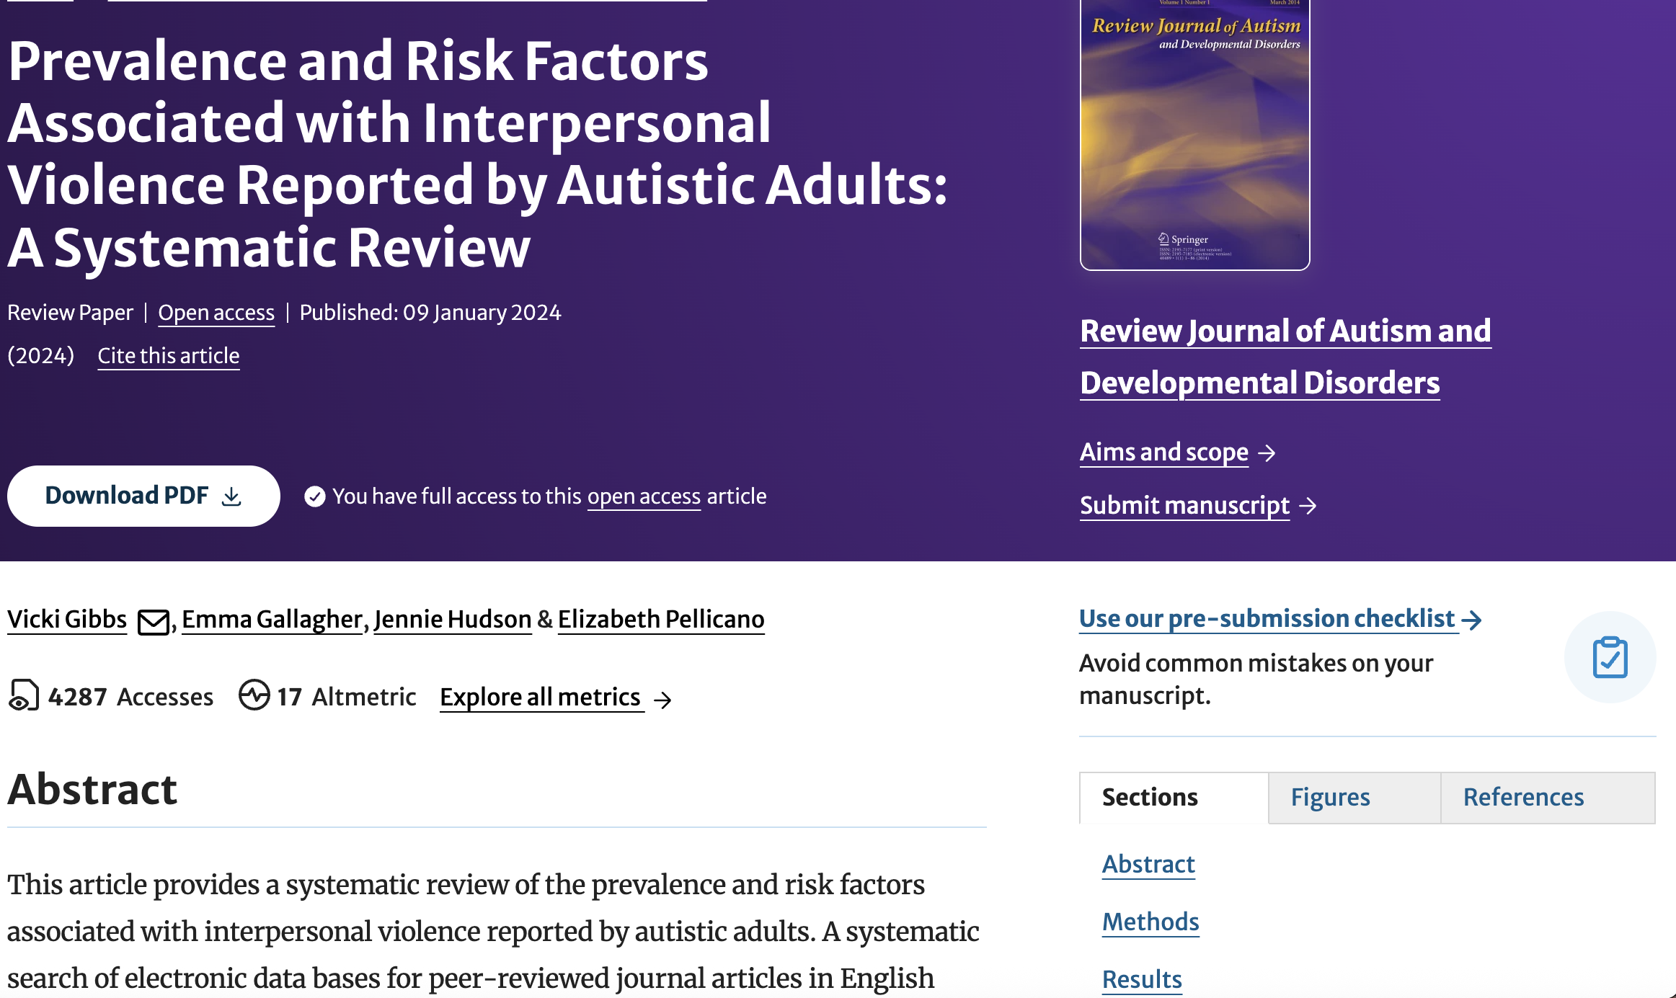
https://rdcu.be/em1JU

Slide 29
IMPORTANT POINTS
Autism is not a tragedy
Trust and believe Autistic communication
Nobody suffers from their neurotype, they suffer from lack of understanding, lack of accommodation and acts of violence against them
Every Autistic person you encounter has experienced some form of invalidation (or worse)
It is OUR job to understand Autistic people and help assure they can communicate their needs and are accommodated appropriately, it is NOT our job to make Autistic people seem allistic

Slide 30
HARM REDUCTION THROUGH GOAL WRITING AND TX PLANNING
Partnering with our patients, clients and students to create goals that affirm their personhood is harm reduction and trauma-mitigation.

Slide 31

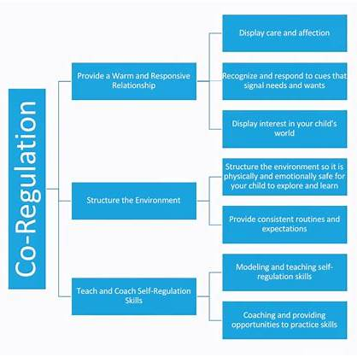
Co-Regulation and Therapy
Understanding Neurodivergent Communication
Recognize diverse communication styles (verbal, nonverbal, AAC, prosody differences).
Avoid assuming deficits—focus on differences and strengths.
Be aware of sensory sensitivities that affect communication and engagement.
Trauma-Informed Principles in Therapy
Prioritize safety, predictability, and trust-building.
Understand that past trauma can influence communication behaviors.
Use a strengths-based, non-judgmental approach.
Affirming Clients’ Communication Preferences
Ask and respect preferred modes of communication.
Collaboratively select strategies and tools (e.g., visual supports, AAC devices).
Avoid imposing neurotypical norms—value authenticity and self-expression.

Slide 32
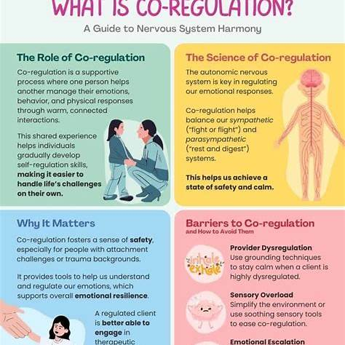
Co-Regulation and Therapy
Co-Regulation Strategies
Recognize signs of dysregulation and respond supportively.
Model calm, intentional pacing and tone in speech and actions.
Use sensory supports, grounding techniques, and flexible session structures.
Personalizing Therapy Approaches
Collaboratively set goals with the client’s priorities in mind.
Integrate interests and strengths to increase motivation and engagement.
Continuously adapt strategies based on client feedback and responses.
Key Takeaways
Affirmation + personalization = empowerment.
Trauma-informed practice requires flexibility, empathy, and co-regulation.
Neurodivergent clients thrive when communication is respected and supported.

Slide 33
Enhancing Health Literacy through Meta- Therapy
Meta-Therapy: A Framework for Enhancing Health Literacy
Definition: Meta-Therapy involves clinician-client dialogues that establish a conceptual framework for therapy, aiming to modify cognitions, knowledge, beliefs, and attitudes.
Application: Incorporating Meta-Therapy into health literacy initiatives can help clients understand and engage with health information more effectively.
Reference: Helou, L. B. (2021). Mapping Meta-Therapy in Voice Interventions onto the Rehabilitation Treatment Specification System. Perspectives of the ASHA Special Interest Groups, 6(1), 1–12. https://doi.org/10.1044/2020_PERSP-20-00072
Notes:
Turn and talk!

Slide 34
Enhancing Health Literacy through Meta- Therapy
Meta-Therapy: Definition and Breakdown
Definition:
Meta-Therapy is a conscious, explicit conversation about the therapy process itself. It focuses on shaping the client’s understanding, beliefs, expectations, and attitudes about therapy, rather than directly producing behavioral or physiological changes. In essence, it’s “therapy about therapy.”
Origin: Originally conceptualized in the context of voice therapy by Leah Helou, Meta-Therapy frames the purpose and process of intervention to empower clients and enhance adherence and outcomes.
Core Idea: Therapy is not only about doing exercises or practicing skills but also about understanding why, how, and what effects these exercises are intended to produce.
Notes:
Turn and talk!

Slide 35
Enhancing Health Literacy through Meta- Therapy
Key Components of Meta-Therapy
Education & Conceptual Framing
  Explaining the why behind each therapy task or exercise.
  Helps clients connect therapy tasks to meaningful outcomes.
  Example: “This breath support exercise strengthens your vocal control so your speech can carry without fatigue. Think of it like training your core for better posture—it supports everything else you do.”
Expectation Management
  Setting realistic goals and clarifying the timeline for progress.
  Helps prevent frustration and disengagement.
  Example: “You might not notice a big change after one session. These changes accumulate over time, like practicing a musical instrument.”
Attitude & Belief Adjustment
  Addressing misconceptions or negative beliefs about therapy or self-ability.
  Reinforces that progress is possible and normalizes challenges.
  Example: “It’s normal for your voice to feel ‘weird’ when trying a new technique—that’s part of learning. It doesn’t mean you’re doing it wrong.”
Self-Monitoring & Reflection
  Teaching clients to observe and reflect on their own performance.
  Encourages metacognition, autonomy, and internal motivation.
  Example: “Notice how your pitch feels after this exercise. What changes do you sense in your effort or fatigue?”
Co-Regulation Integration
  Using Meta-Therapy alongside trauma-informed care and co-regulation helps clients process exercises safely and calmly.
  Example: Before a challenging speech task, the clinician might model slow breathing, explain the physiological response, and frame the task as exploratory rather than “testing” performance.
Notes:
Turn and talk!

Slide 36
Enhancing Health Literacy through Meta- Therapy
Trauma-Informed Care: Creating a Safe Therapeutic Environment
Principles: Safety, trustworthiness, choice, collaboration, and empowerment.
Impact on Health Literacy: A trauma-informed approach ensures that health information is delivered in a way that is sensitive to the client's experiences, promoting better understanding and retention.
Reference: Substance Abuse and Mental Health Services Administration (SAMHSA). (2014). SAMHSA’s Concept of Trauma and Guidance for a Trauma-Informed Approach. https://ncsacw.samhsa.gov/userfiles/files/SAMHSA_Trauma.pdf
Notes:
Turn and talk!

Slide 37
Enhancing Health Literacy through Meta- Therapy
Co-Regulation: Supporting Emotional and Cognitive Engagement
Definition: Co-regulation refers to the process by which a clinician helps a client regulate their emotional state, facilitating better engagement and processing of health information.
Techniques: Modeling calm behavior, using soothing language, and providing a supportive presence.
Benefits: Enhances the client's ability to process and understand health information, leading to improved health literacy.
Reference: Murray, D. W., et al. (2023). Co-Regulation as a Support for Older Youth in the Context of Foster Care: A Scoping Review of the Literature. Prevention Science, 24(8), 1187–1197. https://doi.org/10.1007/s11121-023-01531-3
Notes:
Turn and talk!

Slide 38
Enhancing Health Literacy through Meta- Therapy
Integrating Meta-Therapy, TIC, and Co-Regulation in Health Literacy
Combined Approach: Utilizing Meta-Therapy to frame health information, applying TIC principles to ensure the delivery is sensitive to trauma, and employing co-regulation to support emotional engagement.
Outcome: This integrated approach fosters a therapeutic environment where clients feel safe, understood, and capable of engaging with health information, leading to enhanced health literacy.
Notes:
Turn and talk!

Slide 39
Enhancing Health Literacy through Meta- Therapy
Practical Applications and Strategies
Client-Centered Communication: Tailor health information to the client's level of understanding and emotional state.
Reflective Dialogues: Use open-ended questions and reflective listening to facilitate understanding.
Continuous Support: Provide ongoing emotional support to help clients process and retain health information.
Notes:
Turn and talk!

Slide 40
Enhancing Health Literacy through Meta- Therapy
Concrete Examples of Meta-Therapy in Practice
Example 1: Voice Therapy (Classic Helou Use Case)
Task: Sustaining a vowel sound for 5 seconds.
Meta-Therapy:
  Explain: “This helps your vocal cords work efficiently without strain.”
  Set expectation: “At first, it may feel tiring; over time, it will become easier.”
  Encourage reflection: “Notice how your throat feels—do you feel tension or comfort?”
Notes:
Turn and talk!

Slide 41
Enhancing Health Literacy through Meta- Therapy
Example 2: Health Literacy & Communication Coaching
Task: Explaining a medication schedule to a client.
Meta-Therapy:
  Explain: “Understanding why you take each medication helps you stick to your schedule and reduces side effects.”
  Set expectation: “It may take a few days to remember all instructions, and that’s okay.”
  Encourage reflection: “Can you explain the schedule back to me in your own words?”
Notes:
Turn and talk!

Slide 42
Enhancing Health Literacy through Meta- Therapy
Example 3: Trauma-Informed Speech Therapy
Task: Practicing a social communication script that triggers anxiety.
Meta-Therapy:
  Explain: “We’ll break the script into small steps to reduce stress and help you feel safe.”
  Set expectation: “It’s normal to feel anxious at first; noticing this reaction is progress.”
  Co-regulation: Clinician models calm tone and pacing while guiding the client through the task.
Notes:
Turn and talk!

Slide 43
Enhancing Health Literacy through Meta- Therapy
Why Meta-Therapy Matters
Enhances engagement: Clients understand why exercises matter.
Reduces anxiety and frustration: Expectations and reflections normalize challenges.
Supports autonomy: Clients learn to self-monitor and take ownership of progress.
Amplifies therapeutic outcomes: Understanding therapy deepens motivation and adherence.
Notes:
Turn and talk!

Slide 44
IN REAL LIFE:
Meta-Therapy for Health Literacy & Communication
Scenario: Helping Jordan (autistic, 21) understand and communicate their POTS diagnosis
TIC & Meta-Therapy Principles:
Safety & Predictability: “We can pause or slow down anytime. Your comfort comes first.”
Conceptual Framing: “Knowing POTS helps you explain your needs and understand your body.”
Expectation Management: “It can feel tricky to explain medical info—this is normal. We’ll practice step by step.”
Co-Regulation: Deep breaths and calm pacing to manage anxiety during learning.
Purpose:
Build health literacy (understanding diagnosis)
Develop self-advocacy and communication skills
Notes:
Turn and talk!

Slide 45
IN REAL LIFE:
Stepwise Communication Strategy
Break it down into three parts:
What POTS is: heart rate reacts differently when standing
How it affects you: dizziness, fatigue
What others can do: allow breaks, flexible standing
Practice & Reflect:
“Explain your POTS to me like I’m a coworker/friend/family member.”
Reflect: “What worked? What needs clearer wording?”
Meta-Therapy Focus:
Self-monitoring and reflection
Repetition to build confidence and autonomy
Notes:
Turn and talk!

Slide 46
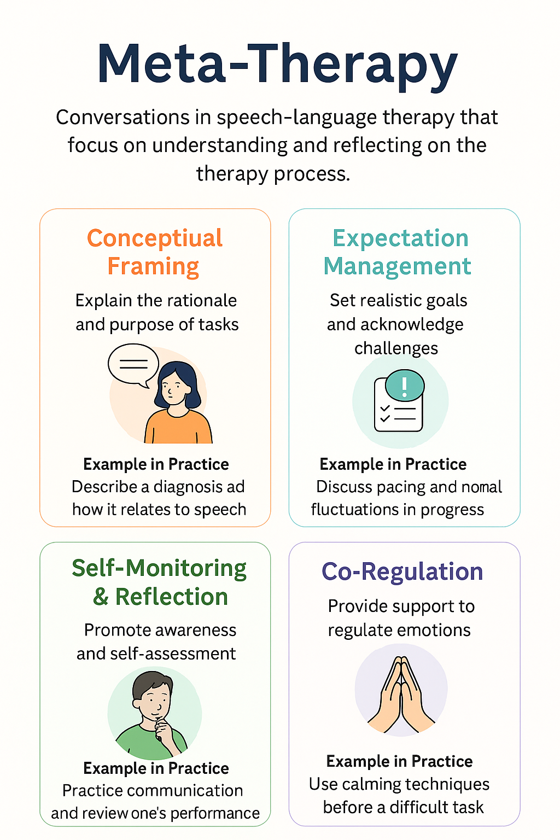
IN REAL LIFE:
Outcomes & Key Takeaways
Benefits for Client:
Clearer communication about health
Increased confidence and self-advocacy
Reduced stress and confusion
SLP Strategies Highlighted:
Use Meta-Therapy to explain why and how exercises matter
Integrate co-regulation to support emotional engagement
Foster health literacy alongside speech-language skills
Notes:
Turn and talk!

Slide 47
What does this have to do with therapeutic rapport and outcomes?
Reframing our approaches:
Shows our clients we are centering them, and not making attempts to assimilate them to the presumed default.
This applies to all goals, interactions and written reports.
When people feel comfortable with you, it shows in their outcomes!

Slide 48
Bringing it all together…
Examining our intersections and approaching our clients and their families from an understanding of lived experience will improve our outcomes! From goal writing to rapport building to health literacy outcomes, we can continue to make a positive impact on each person we serve, embodying person-centered care.

Slide 49
ADVOCACY SCENARIOS
Your colleague is Autistic. She's open about her neurotype and educates others in working with Autistic populations. She's asked for accommodations in the workplace many times, but hasn't received any. She keeps running into institutional barriers like "lack of ability to stop automatic lights from turning on" and "no space for sensory regulation." She educates others in how to accommodate Autistic people but isn't able to advocate for herself in the workplace and be heard. Now she's experiencing burnout and has been placed on probation for needing a reduced schedule. She’s been told that maybe she isn’t cut out for this line of work by a superior.
Factors:
1) This is the only openly Autistic person in the workplace
2) She's been very vocal about things like "please don't support Autism Speaks," but the department still raises money for an Autism Speaks 5k and "lights it up blue" in May
3) You've overheard people saying things like "I wish I could work halfdays 3 times a week..."
4) This colleague has multiple other medical disabilities

Slide 50
ADVOCACY SCENARIOS
A client in your clinic asks to change clinicians after you have an incidental friendly exchange. You ask some questions to see what's going on so that you can talk to your supervisor and the other clinician. The client says that they've been made to feel uncomfortable, as if they aren't committed to their treatment, for missing a few sessions. Their clinician has told them, "if you don't come every week, this treatment won't work," "when I look at your progress, it goes down on our progress monitoring chart after you miss sessions," and has accused the client of being "too emotional."
Factors:
1) The client is a Black Muslim parent of 3 young children
2) They've recently had an MTBI
3) They are neurodivergent at baseline
4) It's Ramadan
5) English is not their primary language

Slide 51

THANK YOU
Contact me:
A.Goldberg@Northeastern.edu
@Transplaining
ACGoldberg.com
TheCREDITsInstitute.org

Slide 52
REFERENCES:
Roberson, K., & Roberson, A. (2024, April 24). Enhancing emotional communication in neurodiverse relationships. Kenneth Roberson, PhD. Retrieved from Kenneth Roberson, Ph.D.
Therapist Neurodiversity Collective. (n.d.). Neurodiversity-affirming therapy: Positions, therapy goals, and practices. Retrieved from therapistndc.org
Complex Trauma Resources. (n.d.). Co-regulation. Retrieved from Complex Trauma Resources
Holmes, K. D. (2023, June 29). Navigating neurodivergence trauma. KD Holmes, LPC. Retrieved from kdholmeslpc.com
Taylor, S., Barr, B.-D., O’Neal-Khaw, J.,Schlichtig, B., & Hawley, J. L. (2018). Refining your queer ear: Empowering LGBTQIA+ clients in speech-language pathology Practice. Perspectives of the ASHA Special Interest Groups, 3(14), 72–86.
Jones DR, Botha M, Ackerman RA, King K, Sasson NJ. Non-autistic observers both detect and demonstrate the double empathy problem when evaluating interactions between autistic and non-autistic adults. Autism. 2024 Aug;28(8):2053-2065.
Braun, V., & Clarke, V. (2021). One size fits all? What counts as quality practice in (reflexive) thematic analysis? Qualitative Research in Psychology, 18(3), 328–352.
Fourie, R. (2009). Qualitative study of the therapeutic relationship in speech and language therapy: Perspectives of adults with acquired communication and swallowing disorders. International Journal of Language & Communication Disorders, 44(6), 979–999.
Helou, L. B. (2021). Mapping Meta-Therapy in voice interventions onto the rehabilitation treatment specification system. Perspectives of the ASHA Special Interest Groups, 6(1), 1–12. https://doi.org/10.1044/2020_PERSP-20-00072
Substance Abuse and Mental Health Services Administration. (2014). SAMHSA’s concept of trauma and guidance for a trauma-informed approach. https://ncsacw.samhsa.gov/userfiles/files/SAMHSA_Trauma.pdf
Murray, D. W., et al. (2023). Co-regulation as a support for older youth in the context of foster care: A scoping review of the literature. Prevention Science, 24(8), 1187–1197. https://doi.org/10.1007/s11121-023-01531-3

